Slide 1

Voice-Controlled Home Automation System using Arduino and Python

Slide 2
Introduction
Overview:
Home automation has become popular, offering convenience, security, and energy savings.
Voice control allows users to interact with appliances without physical contact, enhancing accessibility and ease.
Objective:
The project aims to create a simple, voice-activated system to control household appliances through
Arduino and Python.
Key Components:
Voice Recognition (using Python)
Microcontroller (Arduino) to execute commands
Controlled Appliances such as lights or fans

Slide 3
System Architecture
System Diagram: Display a diagram showing the flow:
Microphone (receives voice commands) → Python (voice recognition & processing) →
Arduino (controls appliances) → Relay Modules/LEDs (indicate appliance states).
Explanation:
Voice Input: Commands are given via a microphone.
Python Processing: Converts speech to text, identifies commands, and sends them to Arduino.
Arduino Control: Receives commands from Python and turns appliances on/off.
Main Components:
Microphone, Arduino, relay modules, LEDs (or other devices)

Slide 4
Working Principle
Voice Command Processing:
Python’s SpeechRecognition library captures and converts spoken commands into text.
For example, commands like “Turn on the light” or “Switch off the fan.”
Communication with Arduino:
Processed text commands are sent to Arduino via serial communication (pyserial).
Device Control:
Arduino receives the command and sends signals to the relay module.
The relay switches appliances (or LED lights) on/off based on commands.

Slide 5
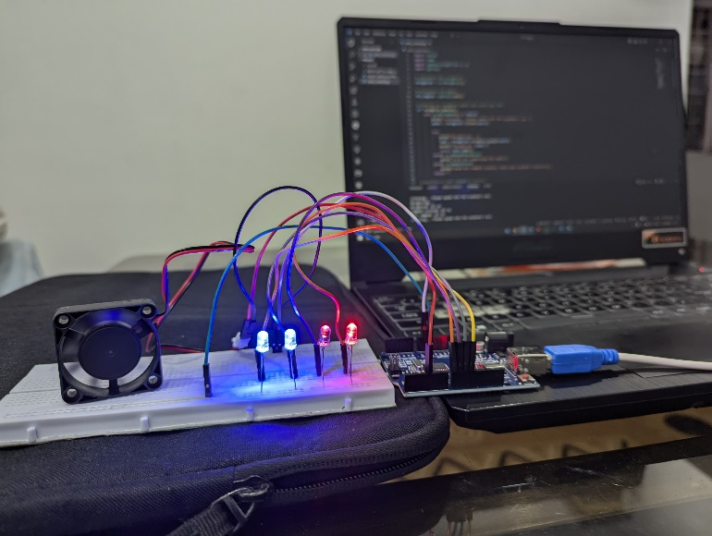
hARDwAre

Slide 6
Conclusion and Future Scope
Conclusion:
Summarize how the system enables hands-free control of appliances.
Emphasize the benefits of using Arduino and Python for automation.
Future Scope:
Add support for more complex commands (e.g., voice commands for temperature control).
Integrate with other platforms (e.g., Google Home or Alexa).
Extend the system for IoT applications with remote access.

Slide 7

Thank You

